Slide 1

The Underlying Causes of Diabetes
Module 8: Project 1
Due date: Thursday, May 4th, 2023
Diabetes Detectives:
Jennifer Bowling
Charles Descheneaux
Justin Mangaroo
Jessica Parker
Jorge Serrano
Data source:
https://www.kaggle.com/datasets/iammustafatz/diabetes-prediction-dataset

Slide 2



What you will learn during this presentation:
Does gender play a role?
Does smoking play a role?
Does hypertension play a role?
Does body mass index (BMI) play a role?
What is the average A1C level that most diabetics have?

Slide 3


Introduction
The Investigation
Diabetic or Non-Diabetic based on age, gender, hypertension(HTN), body mass index (BMI), and smoking.
The following diagnostic laboratory test help diagnose, treat, monitor, and maintain the disease state being investigated. (Glycosylated Hgb(A1C) & Blood Glucose (GLU))
The data was obtained from Kaggle in .csv file format.
The data was analyzed for missing and non-values. Then filtered for ages greater than 30. (Thirty is considered the cut off for Type 2 diabetes.) The data was further filtered for diabetics, non-diabetics, and gender.

Slide 4
Introduction
Diabetes (type 2) occurs in approximately 10% of the US population
In 2020 that was estimated to be approximately 34.2 million people, only ¼ were diagnosed
Risk factors include: smoking, obesity, physical inactivity, A1C, high blood pressure and high cholesterol
Diabetes can cause: heart disease, stroke, lower extremity amputation, hyperglycemic crisis, hyperosmolar hyperglycemic syndrome, hypoglycemia, kidney disease, diabetic neuropathy and blindness
All of these issues puts more strain on the health care system. Understanding the risk factors will allow better treatment plans and better overall patient care.

Slide 5
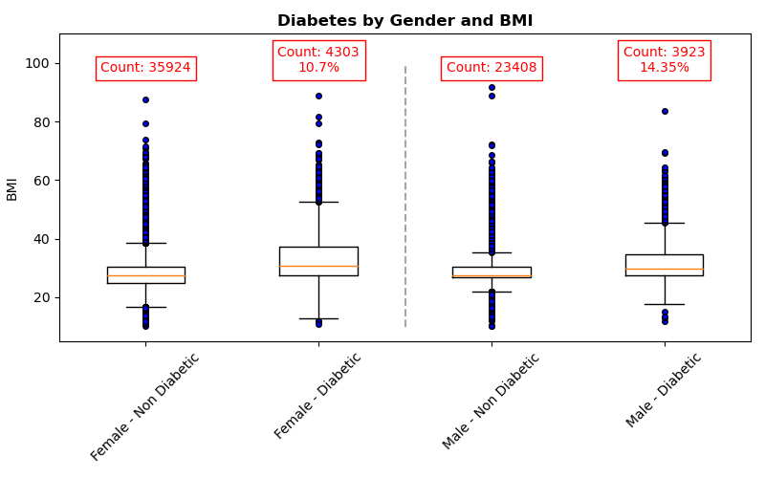
Body Mass Index(BMI): Males Vs. Female - Age > 30
Chi-Square Test for Independence:
Chi-Square statistic: 203.17
p-value: 4.25e-46
Conclusion: There is evidence to suggest gender has an association with diabetes.

Slide 6
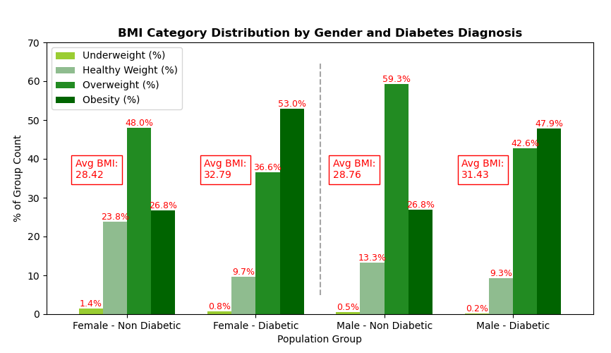
Males Vs. Female - Age > 30 & BMI
Relationship between Gender, BMI, and Diabetes was further explored.
Female BMI and Diabetes:
Mean BMI difference: 28.42 vs 32.79
t-test p-value: 1.03e-225
Point Biserial Correlation: 0.18
Male BMI and Diabetes:
Mean BMI difference: 28.76 vs 31.43
t-test p-value: 3.2e-122
Point Biserial Correlation: 0.21
Conclusion: Given low t-test p-values for both Female and Male the evidence suggests BMI by gender has an association with diabetes. However, this relationship is weak (low r value) and other factors likely contribute to Diabetes.

Slide 7
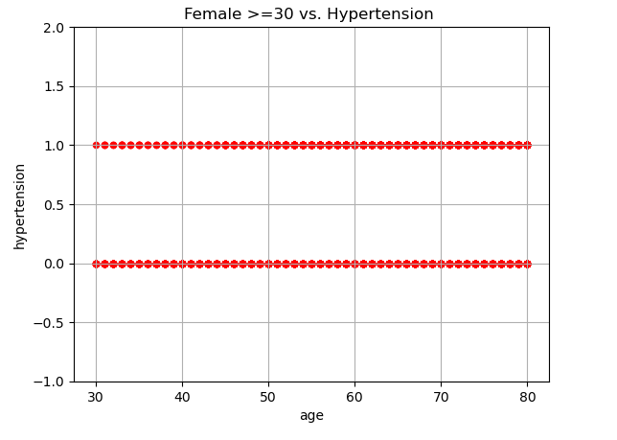
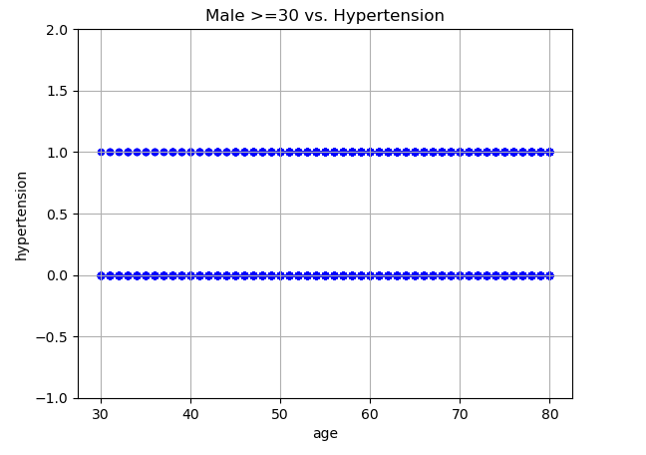
Non-Diabetic: Males Vs. Female -Age > 30

Slide 8
Non-Diabetic: Males Vs. Female -Age > 30

Slide 9
Hypertension(HTN): Males Vs. Female - Age > 30

Slide 10
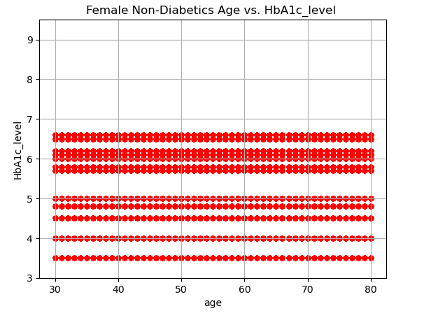
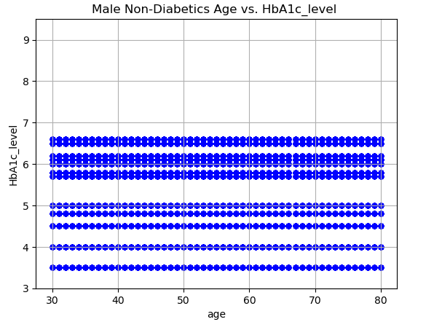
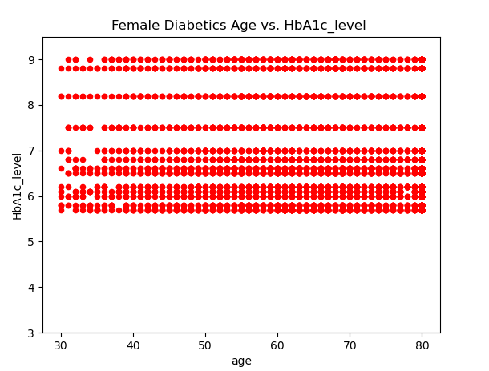
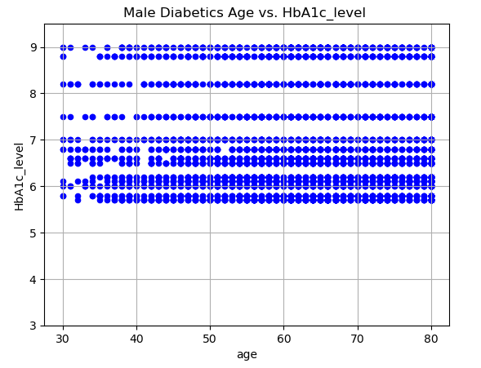
Glycosylated Hgb( A1C): Males Vs. Female - Age > 30
Mean: Female Non-Diabetics 5.39
Mean: Female Diabetics 6.94
Ttest statistic: 89.72 p-value =0.00
Mean: Male Non-Diabetics 5.40
Mean: Male Diabetics 6.93
Ttest statistic: 122.64 p-value=0.00
This shows the AIC in males vs. females is almost identical, however there is a statistically significant difference between the diabetics and non-diabetics.

Slide 11
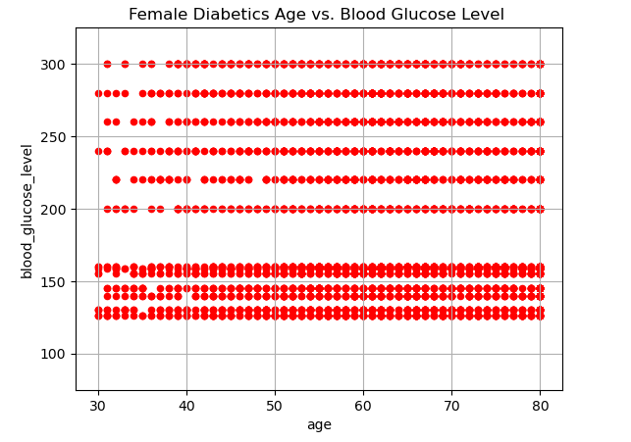
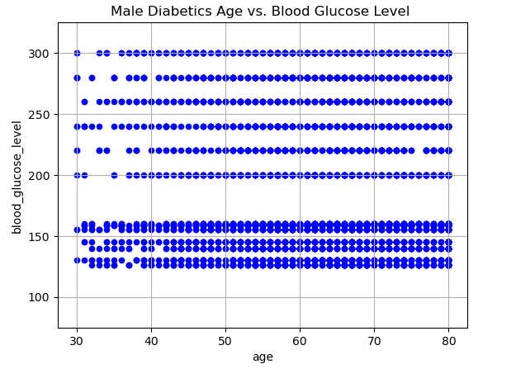
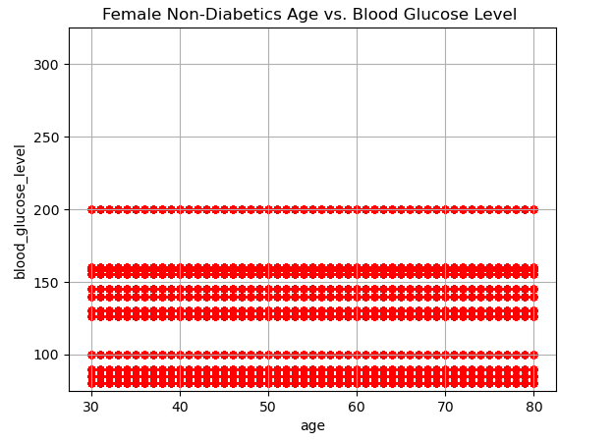
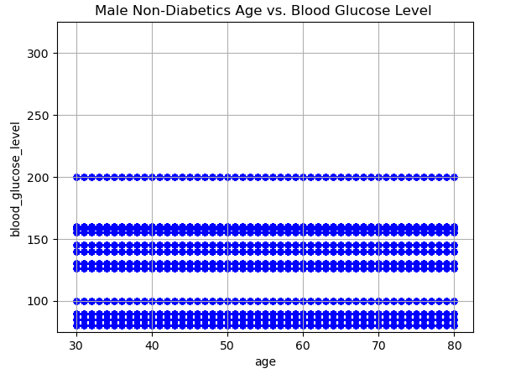
Blood Glucose(GLU):Males Vs. Female - Age > 30
Female Mean Blood Glucose
Diabetics: 194
Female Mean Blood Glucose Non-Diabetics: 132
Ttest value: 67.03 p-value 0.00
Male Mean Blood Glucose
Diabetics: 194.38
Male Mean Blood Glucose Non-Diabetics: 132.92
Ttest value: 64.03 p-value 0.00
This shows there is practically no difference between the male and female diabetics and non-diabetics with regard to the blood glucose level, however there is a significant difference between diabetic and non-diabetic blood glucose levels.

Slide 12
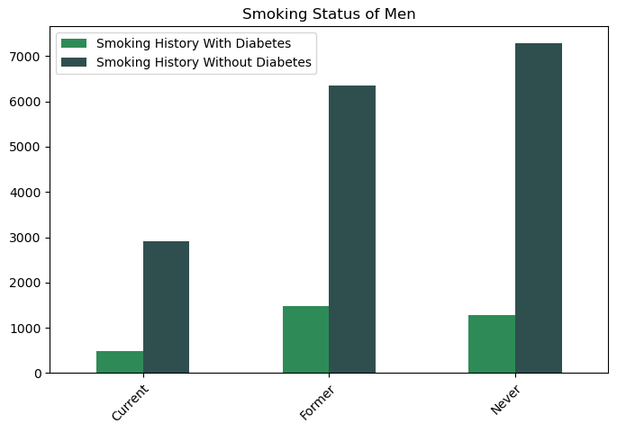
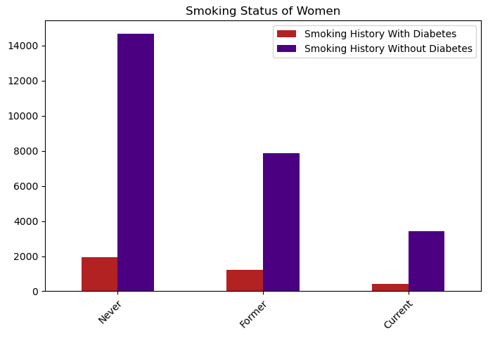
Smoking: Males Vs. Female - Age > 30

Slide 13

Conclusion: Diabetes effects males and females at about the same rate when looking at: BMI, AIC, blood glucose and smoking.

Slide 14


Thank You!

Slide 16
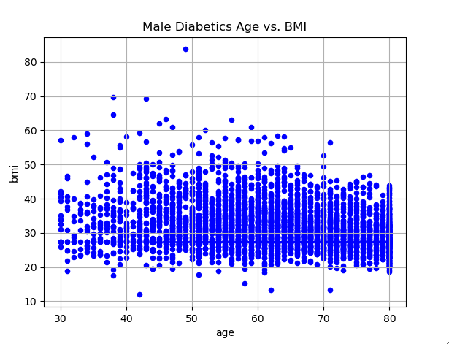
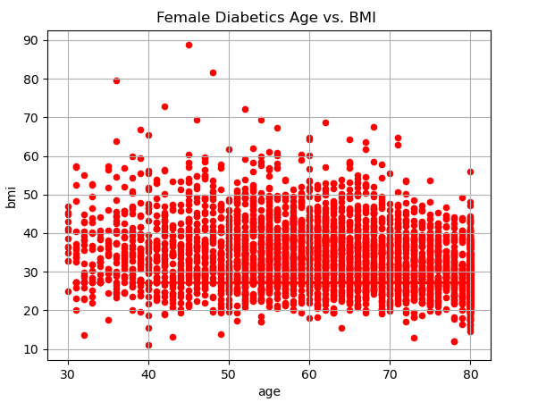
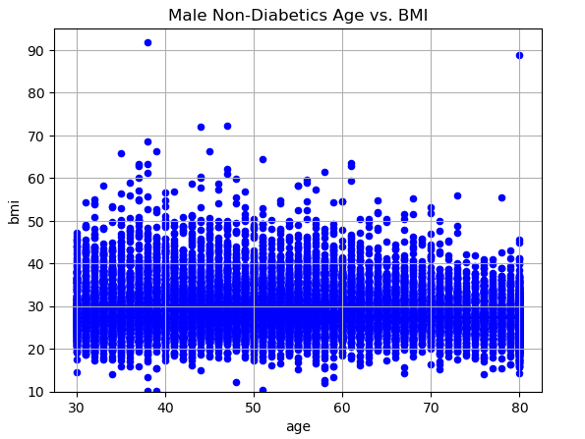
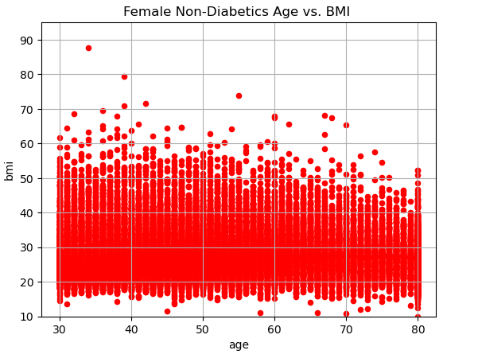
Body Mass Index(BMI): Males Vs. Female - Age > 30

